Slide 1

Towards Open Science: Developing Workflows for Archiving & Publishing Data
How to achieve: “as openly as possible, as closed as necessary”?
Nami Sunami
Data Steward | TU Eindhoven
n.sunami@tue.nl
DOI: 10.53962/q7wh-xtcj
This work is marked with CC0

Slide 2
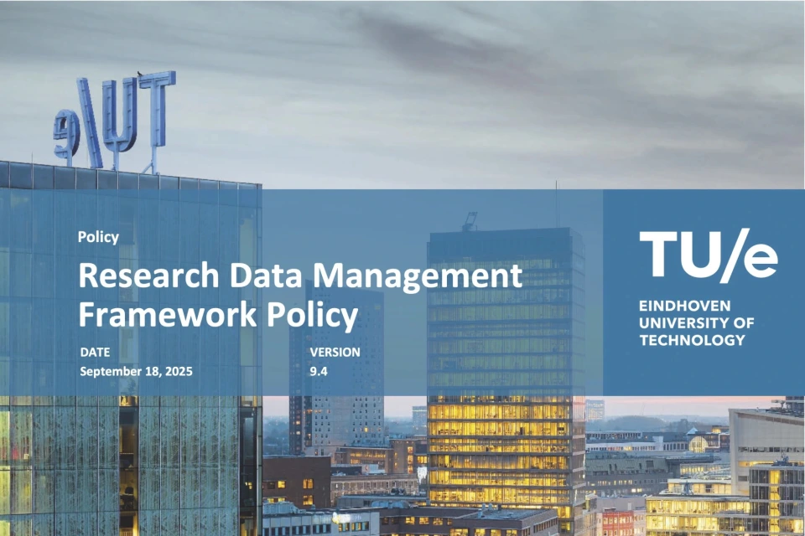
New: Policy on Research Data Management
Most research projects need a Data Management Plan (DMP)
PhD candidates need to submit their DMP to Hora finita
More info:
TU/e Intranet: Research Data Management Framework Policy
The data stewards team offer presentations. Contact: rdmsupport@tue.nl
Policy PDF: https://zenodo.org/records/15309047

Slide 4
My story as a Data Steward does not make sense, except in the light of ____________.

Slide 5
My story as a Data Steward does not make sense, except in the light of Open Science.

Slide 6
Open Science is not only about publications. It’s also about data—making data FAIR.

Slide 7
What is FAIR data?

Slide 8




Findable
Accessible
Interoperable
Reusable
Open Data
FAIR Data
Notes:
FAIRデータ日本語：https://biosciencedbc.jp/about-us/report/fair-data-principle/
Findable and accessible can be covered by being open, but not other two

Slide 9

Research Data as a Public Good
OECD Principles and Guidelines for Access to Research Data from Public Funding (2007)

Slide 10
Data stewardship: Taking care of data well

Slide 11





We used to mistreat research data
Paper
Data never to be looked at again
Create Data
Consume Data
Data loss & research waste
Notes:
Traditionally, we thought research data as something to be consumed, with a dead end

Slide 12
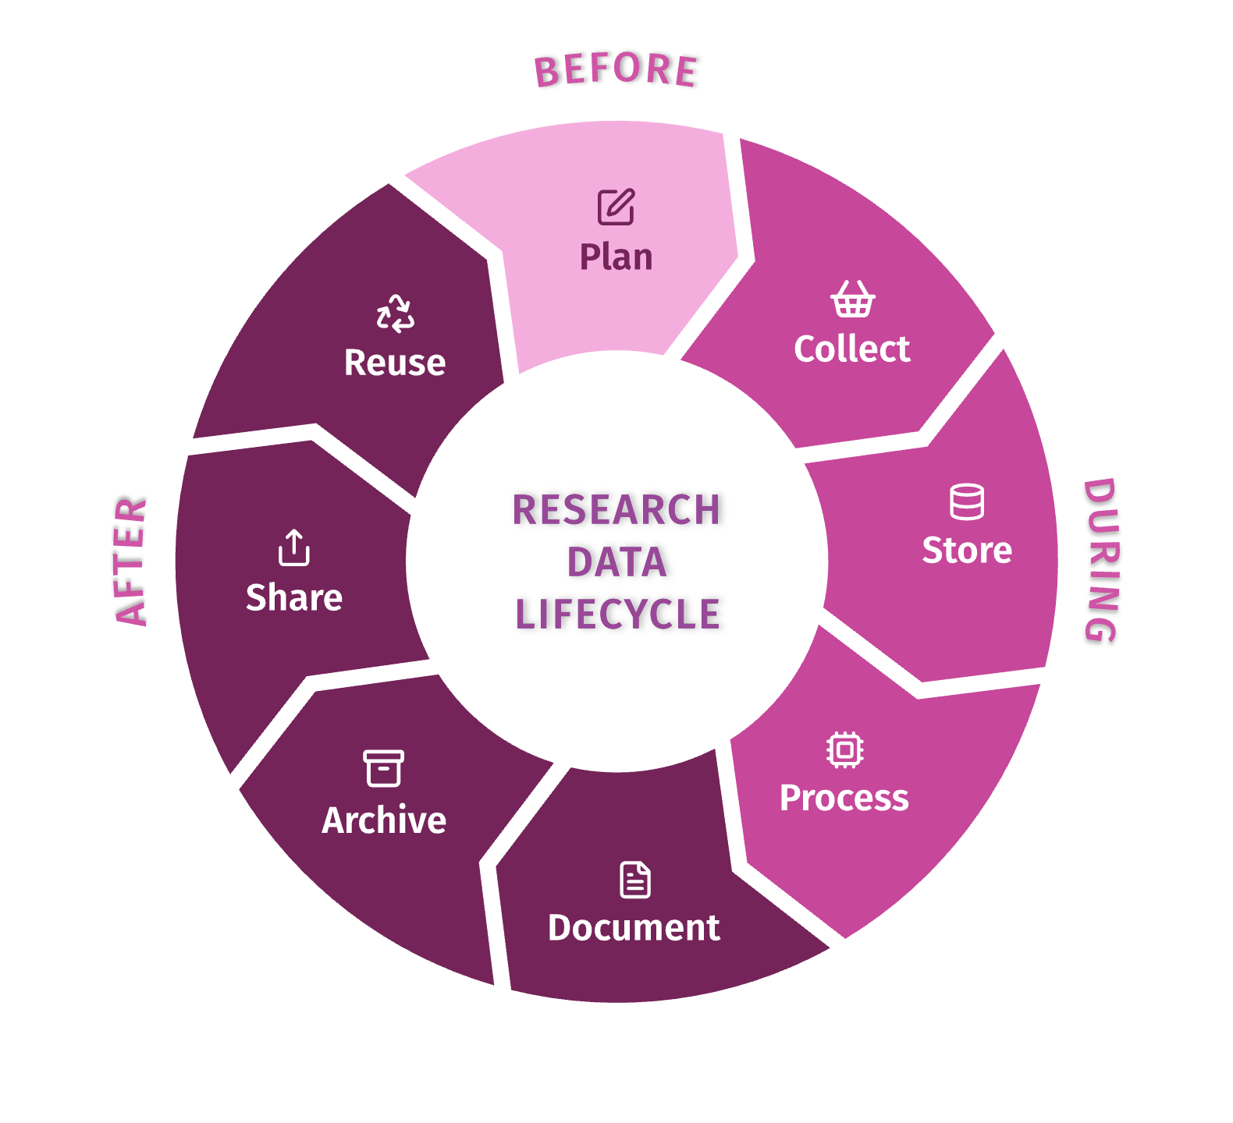
We can take care of data better in a lifecycle
From TU/e Research Data Management Handbook: https://rdm.tue.nl/docs/intro
Notes:
Research data management concerns the way you collect, analyze, store, share, archive and publish research data, to satisfy the needs of current and future data users​.

Slide 13
Plan ahead to avoid hassle at the end

Slide 14
Effort
“What did I do again?”
“Where’s my data?”
“No time to spend for planning now.”
Project Start
Project End
Notes:
(In the past, we scramble ourselves to structure metadata and data at the end of the project )
But, it’s worse way to do it—time consuming, accuracy, remembering everything, “past you”

Slide 15
Ideal: Start with the end in mind

Slide 16
Effort
Completing a Data Management Plan
Archiving & publishing data as planned
Project Start
Project End

Slide 17
What is archiving and publishing data?

Slide 18
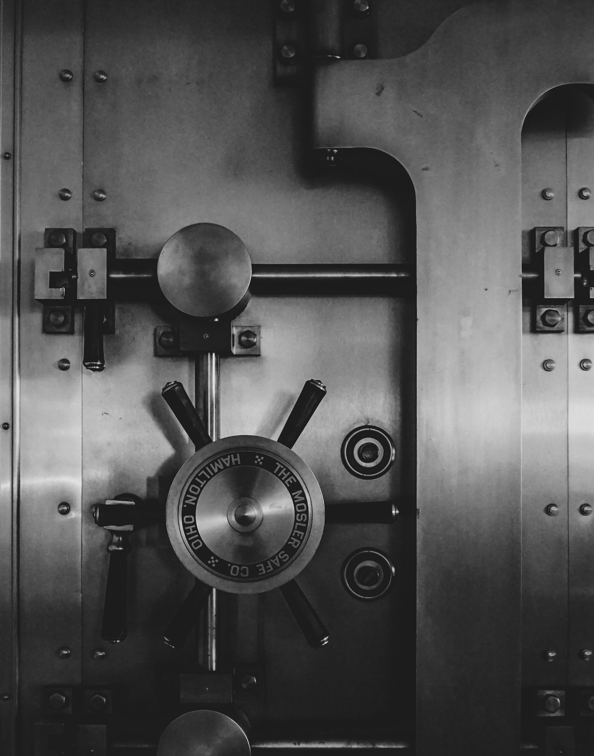
Archiving: To demonstrate the integrity of research
Each publication requires an archival package
Archival package is usually kept internal
TU/e Archival Solution is under development (RAPS)
Photo by Jason Dent on Unsplash
Notes:
RAPS is developed by the Research Data Literacy & Curation team, https://tuenl.sharepoint.com/sites/intranet-LIS/SitePages/Research-Data-Literacy-and-Curation.aspx

Slide 19
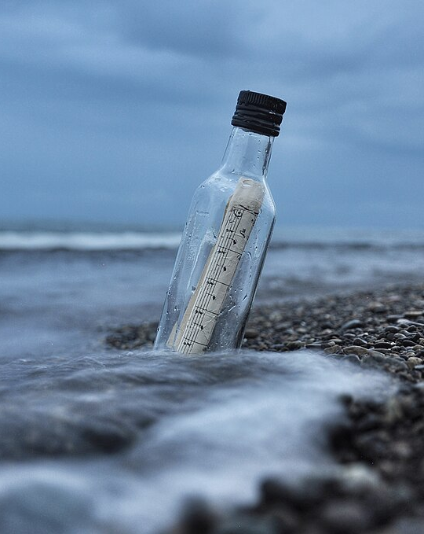
Publication package: To share your data
The goal is to share data with future data users (including you in the future)
Snapwire, CC0, via Wikimedia Commons

Slide 20




Publication
Archival
To demonstrate integrity
Goal
To share
Public
Can be restricted
Access
By default

Slide 21
How can we archive and publish?

Slide 22
My suggestions for the workflow
(Note: Please chime in if they don’t work for you!)

Slide 23
Suggestion 1 Use Research Cockpit to register projects as soon as possible
https://cockpit.research.tue.nl
Getting an ID for your project
Completing a Data Management Plan

Slide 24


Suggestion 2 Reserve a DOI for the project beforehand
You can put the DOI when creating a Data Management Plan

Slide 25
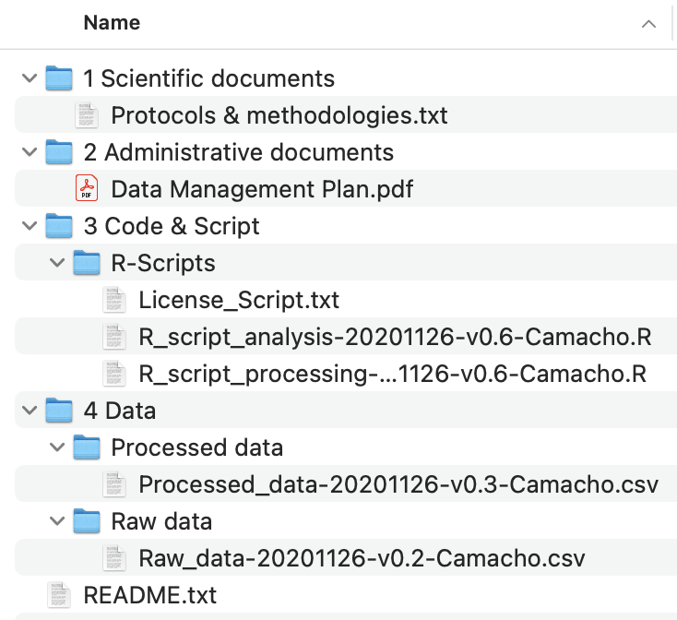
Suggestion 3 Store data in a packaged way during research
TU/e Research Cockpit: Step-by-step guide to create an archival package
Notes:
https://datapackage.org/

Slide 26
Suggestion 4 Decide on a default license for data that can be shared publicly
Data stewards’ suggestion: CC BY 4.0 for data & MIT for code

Slide 27
Suggestion 5 Share early with metadata-only record without uploading data
(especially relevant for data that cannot be shared publicly)

Slide 28
Timeline
To Do
Resource
Project Start
Project Registered & DMP Created
Research Cockpit
DOI Reserved
4TU.ResearchData / Zenodo
Data Stored in a Packaged way
Data packaging guideline
Publication submitted
Metadata-only record published
4TU.ResearchData / Zenodo
Publication accepted
Data published
4TU.ResearchData / Zenodo
Project End
Data archived
TU/e RAPS (coming soon)

Slide 29

Suggestion 6 Reach out to the data stewards team for questions
rdmsupport@tue.nl
rdm.tue.nl
Nami Sunami
CE&C, APSE
n.sunami@tue.nl

Slide 30
We all already do data stewardship

Slide 31
Further resources
More info on RDM
Contact Data Steward
rdmsupport@tue.nl
Data Stewards | Intranet
TU/e Research Data Management Handbook
Search Storage | Storage Searcher
Create a DMP/ ERB
TU/e RDM Policy
Research Cockpit
Policy PDF: https://zenodo.org/records/15309047

